Slide 1
EDA ON WORLDS POPULATION
INFERENCES:
Population of the successive years are more important data to predict the next year population as they are highly corelated.
Area is not well corelated.
Africa has high growth rate but Asia has high in rank of population while North America and Oceania has low rank in population
Scatter plot represents the growth rate with respect to country and world population percentage.
Country India and china has highest population among all countries in 2022
In all years, India and China are highly populated Countries.

Slide 2
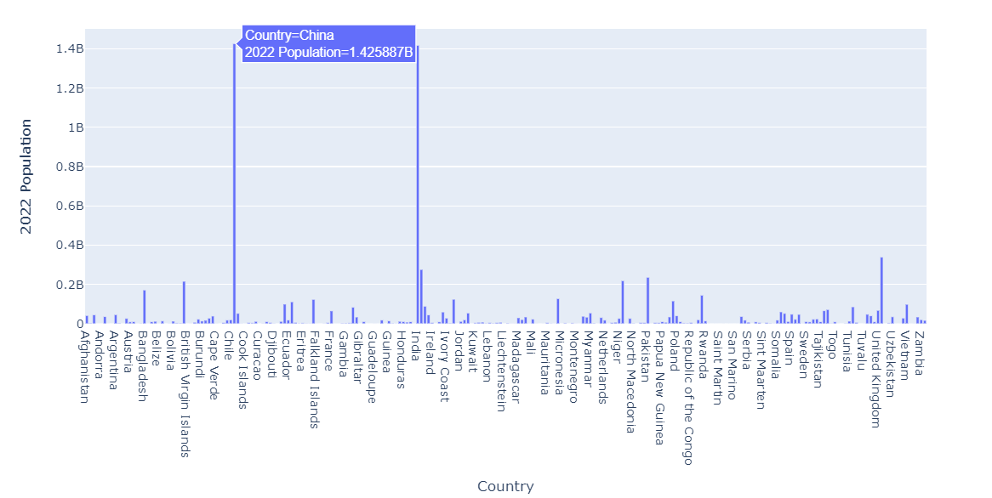

Slide 3
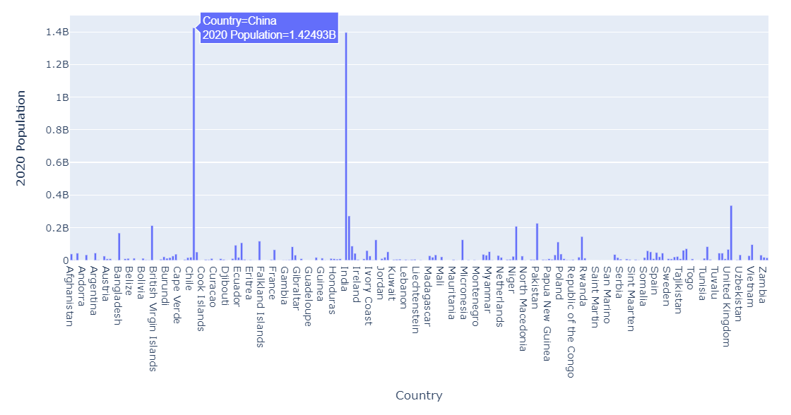

Slide 4
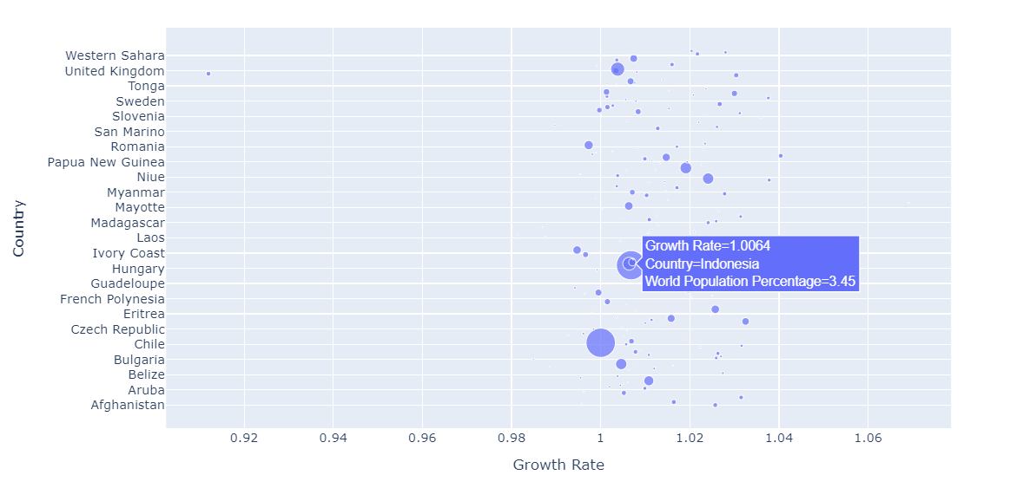

Slide 5
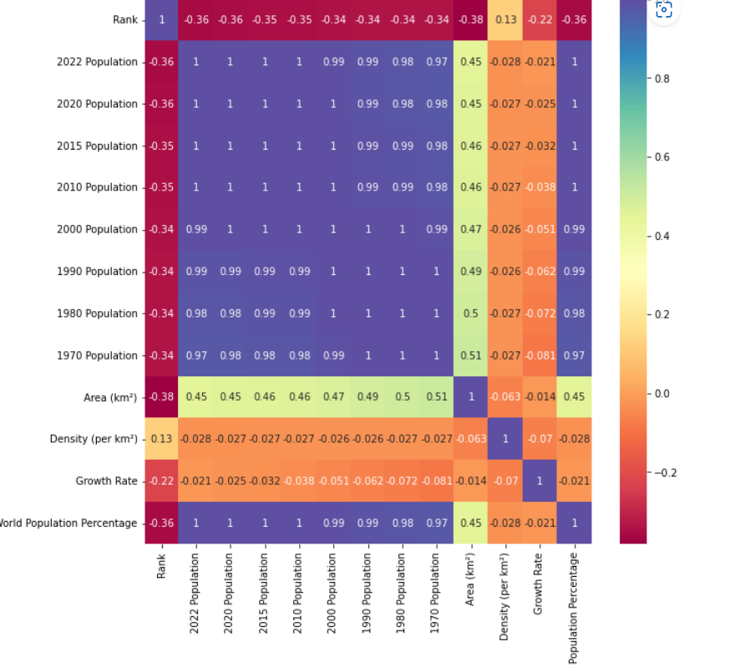

Slide 6
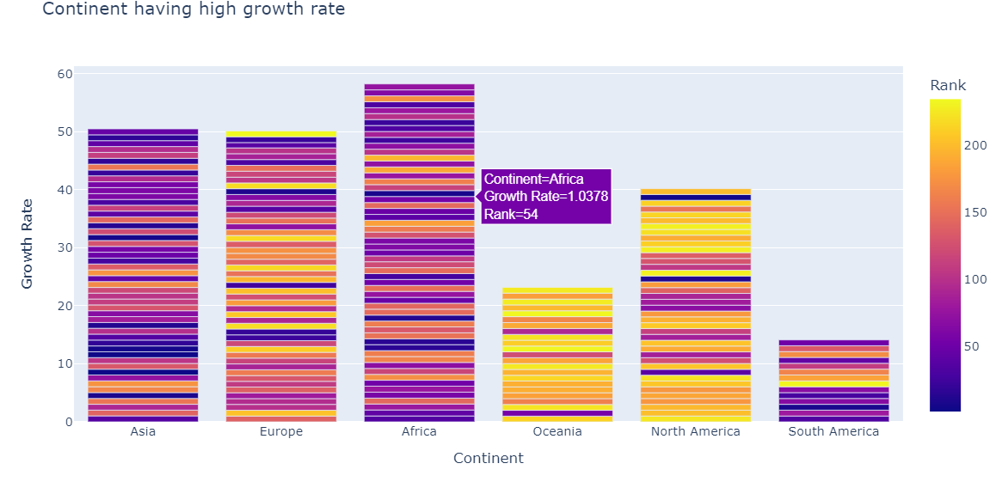

Slide 7
